Slide 1
Lawyer Wellness; How to Identify & Get Help Managing Stress & Anxiety
May 3, 2021

Slide 2
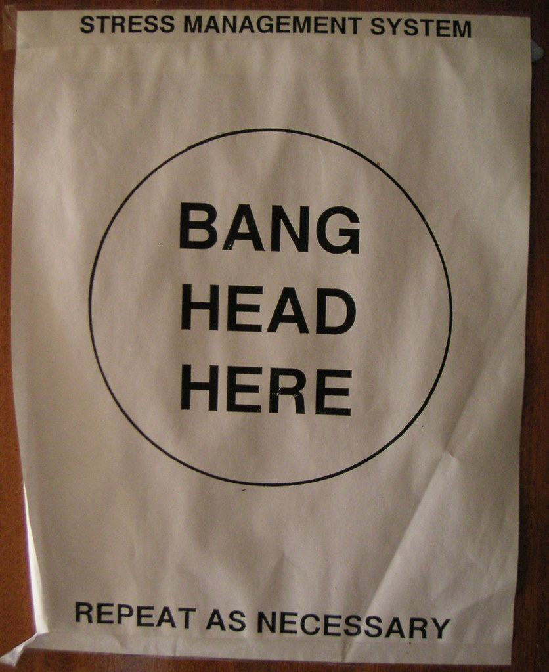
How many of you use this stress management system?

Slide 3
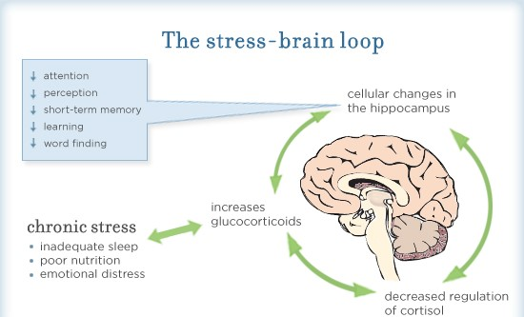
Stress and your brain
When a person feels this way, they often try harder to manage these symptoms, which may make them worse. It is a vicious cycle.
The 2016 ABA/Hazelden Betty Ford study discovered that:
- 19% of lawyers experience anxiety; and - 23% experience chronic stress.

Slide 4
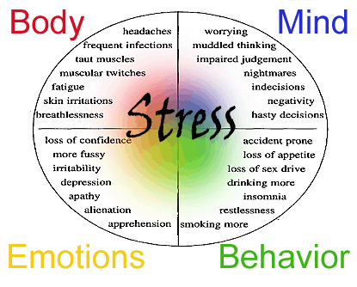
How does our emotional state impact our life?

Slide 5
Factors that influence stress and anxiety in the practice of law.
Time constraints.
High stakes cases, involving your clients property or freedom.
Clients’ expectation of a certain level of expertise, whether realistic.
Feeling judged and scrutinized by colleagues, judges, and juries.
Persistent fear of malpractice claims or ethical complaints.
The adversarial nature of law; constant state of conflict with opposing counsel and their desire to prove you wrong.
Legal landscape becoming more hostile, and less cordial.
Personal burdens that can often parallel with your clients’ burdens.
Bill, bill, bill, bill, bill, bill.
Constant vigilance; preparing for the worst care scenario all the time.
Feeling you will be perceived as being “weak” for showing emotion or vulnerability or struggling with a case.
“13 Reasons why lawyers are so stressed out.” Molly McGrath, March 2019.

Slide 6
What is Resilience? Why is it important?
Resilience is being able to adapt to life's misfortunes and setbacks.
When something goes wrong, do you fall apart or bounce back?
Are you able to adapt to adversity?
Do you continue to function, work and, engage in life; or do you miss work and disconnect from life, work, and family?
Do you feel victimized and become overwhelmed or reach out to those you trust?
Lack of resilience will not end your problems or those of your family members, but it can give you the ability to see past them and engage in healthy coping skills.
Resilience is not:
Putting up with difficult situations/people,
Being stoic, or
Managing on your own.
Source: The Mayo Clinic.

Slide 7
What is Resilience? Why is it important?
Resilience:
Has being able to reach out for support as a key ingredient.
Can help protect us from mental health issues, including anxiety and depression,
Can offset factors that can exacerbate mental health conditions.
Improves your ability to cope.
Continued
“Resilience: Build skills to endure hardship” The Mayo Clinic. October 2020.

Slide 8
Resilience: This speaks to ones ability to survive and thrive when faced with many difficult stressors. - Often resilience is used when describing clients, friends, and family members’ coping. - What about the resilience it takes to get through a challenging case, hearing a client’s trauma, cases bringing to mind you experienced or witnessed in the past?
We practice resiliency through having meaningful relationships with others.
We accept the tension between work and carving out time to decompress.
We establish a balance. Lawyers often feel guilty for taking time for themselves. There is no magical moment when balance happens; it is a practice. Your needs will change based on what is going on (e.g., the night before trial, your desire to have “me time” will seem selfish or impossible). Find small reasonable ways to manage. Often waking outside or to lunch if possible is enough to reset and continue working.
Self-care actually helps to become more resilient and able to manage stressful situations or cases easier than just “grinding thru.”
Acknowledgement versus ignoring is key.
Each person has different needs of how much self-care is needed. The key is to understand your needs for self-care.
“Relaxing the anxious lawyer brain takes practice.” Jeena Cho. ABA Journal, September 2018.

Slide 9
Reframing Unproductive Thinking
Seek to understand where you can have a measure of control or influence in a situation versus hyper focusing on what you cannot control or influence.
Find measurable and specific evidence to support the accuracy of your thoughts (assess assumptions).
Try to avoid black-and-white, all-or-nothing, thinking styles.
Consider what would you tell a friend or colleague in the same situation. We often give better advice to others than what we would do.

Slide 10
Self- monitoring
One of the most successful techniques in beginning to identify and change our behaviors or negative thought patterns.
This specifically means paying attention to a specific thought, feeling, social interaction, or behavior.
Anticipate experiences that could temp you to use old, self-defeating behaviors or thoughts.
Prepare to use alternate behaviors that can substitute for the old, destructive, and unhealthy thought patterns or behaviors.
Stay in the moment, consciously noticing how well the new behavior or thought pattern is working.
Debrief: when the situation has passed, take time to evaluate and self-assess how things went (e.g., give yourself credit and grace).
Relapse Prevention Therapy Workbook, pp. 14-15.
Terence Gorski and Stephen Grinstead, 2010.

Slide 11
Self-monitoring
Change your body posture; get up!
Body check: where do you carry your stress? This can be a great warning sign that your body is giving you. Move and stretch.
Detach and choose to relax. “What can I control?” “Is there anything I can do differently?”
Walk outside or even standing outside your home or office.
Call someone with whom you can check in, someone supportive and understanding
Exercise… I know, we can all be “too busy” … but, it works! Figure out what works for you.
Plan things to do with family and friends that have nothing to do with work. Maintain friendships with individuals who are in other professions (Often, when you get together with co- workers, the discussion turns to work; and it feels like work).
Continued

Slide 12
Reframing Unproductive Thinking
Avoid perfectionism (difficult, but not impossible).
This thought pattern and personal expectation is associated with being internally focused, self-oriented, and egocentric.
This self-centeredness is the opposite of connection with others and is associated with negative personal outcomes.
This trait is associated with higher overall levels of anxiety, burnout, substance use, and unhealthy coping skills and habits.
Avoid thinking “What will others think about ___?”
These thought are unproductive.
You have zero control over what others think of you.
This is one of the main thoughts that lead to increased anxiety, stress, and perfectionism.
Continued
“What Resilient Lawyers Do Differently.”
Paula Davis-Laack, Forbes. September 26,2017.

Slide 13
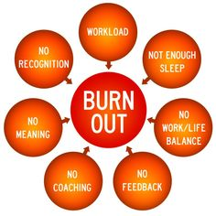
How burnout impacts all areas of your life.

Slide 14
Definition of Compassion Fatigue
Elements:
The cumulative physical, emotional, and psychological effects of continual exposure to traumatic or distressing stories or events.
When working in a helping capacity.
Where demands outweigh resources.
Compassion fatigue seems directly related to the amount of emotion shared.
“Becoming Compassionately Numb,” Robynn Moraites.
New York Times Sunday Review, 2011.

Slide 15
Common signs of compassion fatigue.
Intrusive thoughts
Anger, anxiety, and/or excessive fear
Sleep disturbance
Fatigue
Loss of appetite
Loss of empathy
Loss of faith in humanity
Sense of isolation from others
Physical complaints
“Vicarious Trauma: The Impact on Solicitors of Exposure to Traumatic Material,” Vrkelvski and Franklin. Traumatology, 2008.

Slide 16
What do we do now?
Recognize Bias (Its impact our ability to recognize the need and ask for help).
Learn (i) new routines and new skills/tools; (ii) how to self assess, including identifying your triggers for stress.
Anticipate stressful situations or feelings.

Slide 17
Biases
Implicit biases: Sourced by societal input that escape conscious detection.
Pay attention to helpful biases; keep negative, prejudicial, or accidental biases in check. This requires a delicate balance between self-protection and empathy for others.
Cognitive biases: Repeated patterns of thinking that lead to inaccurate or unreasonable conclusions.
Cognitive biases may help people make quicker decisions, but those decisions are not always accurate. It is important to (i) be aware of cognitive biases when assessing thoughts, behaviors, interactions, or research and (ii) attempt to counter their effects.
Confirmation biases: The brain’s tendency to search for and focus on information that supports what someone already believes while ignoring facts that go against those beliefs, despite their relevance.
Attribution bias: Occurs when someone tries to attribute reasons or motivations to the actions of others without concrete evidence to support such assumptions.
The key is acknowledgment, awareness, and management of these biases.

Slide 18
Blind Spots
We all have blind spots regarding our hidden biases.
“We all carry from a lifetime of exposure to cultural attitudes about age, gender, race, ethnicity, religion, social class, sexuality, disability status, and nationality.” This is also how we are raised; the language used in our family systems, homes, friends’ homes, religious institutions, schools, etc.
This happens without our awareness or “conscious control.”
We want to believe we are very aware of these thoughts or biases and counteract them, but our individual exposures regarding social groups subtly inform our thoughts, ideas, and opinions. These perceptions shape how we interact with people from the different social groups.
How do we bring hidden biases into the light and have more insight into why and how we can change? More importantly, what are we willing to do to improve awareness and change?
Blind spots can shape our likes, dislikes, and judgments.
Blindspot, Banaji and Greenwald (2013).

Slide 19
Recovery
Types of Recovery:
Individual may be in recovery from trauma, addiction (e.g., alcohol, drugs, gambling), codependency, mental health disorders, eating disorders, etc..
A person may be in recovery from one area of concern or for co-occurring disorders.
Addiction Recovery and Social Distancing:
For those in recovery for addiction, it can be very challenging to attend 12-step meetings or meet with your sponsor.
Many areas have virtual meetings (e.g., Zoom) and participants may attend any group anywhere.
Virtual platforms have been used to meet with sponsors and sponsee (e.g., FaceTime or Skype).
Many groups have private web pages (e.g., on Facebook ) that are focused on recovery, provide meeting information, and give and provide resources for support. These are monitored closely and anonymity is maintained.
Telehealth has been used to stay in contact with therapists, psychiatrists, psychologists, primary care physicians, etc. These meetings can still be maintained.
Maintaining Connection: Creating a support system of allies can be invaluable. These are family members, friends, anyone who is accepting and supportive of you and your recovery.
It is important for us to be SEEN during this time,
we can all sound good on the phone when needed.

Slide 20
Routines, Boundaries, and Gratitude
Routines
Creating a routine helps us to feel safe, secure, and grounded.
Be flexible with your routines; life can happen and you might have to alter from time to time.
We can do this, once established, without thought; it becomes; second nature.
This can happen when you can identify your needs and are in tune with your body and mind.
Set a routine that is manageable from where you are; something that is attainable.
Boundaries:
We set boundaries for ourselves…and others.
We teach people how to treat us….read that again

Slide 21
Routines, Boundaries, and Gratitude
Established boundaries/routines can look like:
Having a morning and evening routine; this helps your mind and body get going or relax.
Taking a break mid-day (e.g., going outside; eating away from your desk; going to the gym, for a walk, or watching your favorite show during lunch).
Setting up a workspace that is peaceful (e.g., pictures of loved ones, items on your desk that remind you of a fun time or a special memory or that your child made).
Listening to music or a podcast; this can help some concentrate or distract during mundane tasks.
Have your workspace face or be near a window. Get that benefit of Vitamin D. Opening your window can bring in the outdoors and engage your senses through smelling the outside air and hearing the sounds of the neighborhood.
Continued

Slide 22
Routines, Boundaries, and Gratitude
Routine and Boundaries
Have a set time for the day to begin and end, and close the door (or “retire” the workspace) when the day is done.
No checking emails, phone calls that are work related, etc.
Change the setting on your phone for email alerts.
If needed, set a specific time, with a limit, to check later.
Designate a workspace/zone. Moving your laptop around your home creates the idea that your whole house is a workplace. Let your workspace, at home or in the office, reflect your personality. Find a way to weave into that space more of you.
Make a gratitude list daily, in the morning and evening are a great way to reflect on your day. This is simple, list 3 things to start with.
Gratitude
Making a gratitude list daily,
in the morning and evening,
is a great way to start and reflect on your day.
This is simple; list three things to start.
Continued

Slide 23
The Virginia Judges & Lawyers Assistance Program
Confidential * Non-Disciplinary * No Cost
ASSISTS CONFIDENTIALLY
attorneys, judges, law students and other legal professionals who may be impaired by mental health or substance use concerns.
PROVIDES SERVICES
such as evaluations, assessments, and referrals to health care programs and providers competent to work with legal professionals.
EDUCATES
the judiciary, bar associations, law schools, law firms, and other groups about mental health and substance use in the profession.

Slide 24
VJLAP Support Groups.
These support groups are confidential and not a therapeutic group.
These are facilitated by VJLAP staff.
Normally are held across the state, but now all are virtual.
Wellness groups and 12-step groups available
Specialty groups include: women's support and gambling support group.
You can find the VJLAP support groups on our Events Pages: https://vjlap.org/events/2021-05/ .

Slide 25
What VJALP does? www.vjlap.org info@vjlap.org 24/7 HelpLine: 877.545.4682
Statewide. Independent, Non-Profit Organization. Confidential. Voluntary. Non- disciplinary. No Cost.
We assist with referrals to therapist, psychiatrists, or treatment, as indicated
Work with Virginia’s law students, law schools, and bar applicants.
Provide CLE’s to local and specialty bar association’s, law firms, and anyone affiliated within the legal arena/practice.
Monitor lawyers who voluntarily agree to enter into a Rehabilitation Monitoring Contract (even when referred, participation is voluntary).
Provide information, outreach, and resources to concerned individuals, colleagues, and family members.
Contact Us
Tim Carroll, MBA
Executive Director
804.644.3212
Jim Leffler, LPC
Clinical Director
(Richmond Area)
804.614.5841
Barbara Mardigian, LPC
Deputy Clinical Director
(Northern Virginia Region)
703.206.8027
Angeline Lloyd, LPC
(Southwest Region)
276.920.8133
Janet Van Cuyk, MSW, JD
(Tidewater & Charlottesville Areas)
757.775.0058

